Slide 1
Operating System Structure Module 2
Operating Systems
Nadia Qureshi

Slide 2
Operating System Services

Slide 3
Operating System Services
Operating systems provide an environment for execution of programs and services to programs and users
A set of operating system services provides functions that are helpful to the user
User interface
Almost all operating systems have a user interface (UI)
Varies between Command-Line (CLI), Graphics User Interface (GUI), Batch
Program execution
The system must be able to load a program into memory and to run that program, end execution, either normally or abnormally (indicating error)
Notes:
Batch Interfaces are set to run on a designated schedule, usually overnight. They cannot be manually initiated. These interface calls are initiated by specific criteria or triggers, for example, adding a person to a case, a consumer turning a certain age, or updating or editing data elements in KEES.

Slide 4
Operating System Services
I/O operations
since user programs cannot execute I/O operations directly, the operating system must provide some means to perform I/O
File-system manipulation
Programs need to read and write files and directories, create and delete them, search them, list file Information, permission management
Operating system helps the programs to achieve that

Slide 5
Operating System Services
Communications
Processes may exchange information, on the same computer or between computers over a network
Communications may be via shared memory or through message passing (packets moved by the OS)
Error detection
OS needs to be constantly aware of possible errors
May occur in the CPU and memory hardware, in I/O devices, in user program
For each type of error, OS should take the appropriate action to ensure correct and consistent computing
Debugging facilities can greatly enhance the user’s and programmer’s abilities to efficiently use the system

Slide 6
Operating System Services
Resource allocation
When multiple users or multiple jobs running concurrently, resources must be allocated to each of them
Many types of resources - Some (such as CPU cycles, main memory, and file storage) may have special allocation code, others (such as I/O devices) may have general request and release code
Accounting
To keep track of which users use how much and what kinds of computer resources

Slide 7
Operating System Services
Protection and security
The owners of information stored in a multiuser or networked computer system may want to control use of that information, concurrent processes should not interfere with each other
Protection
involves ensuring that all access to system resources is controlled
Security
of the system from outsiders requires user authentication, extends to defending external I/O devices from invalid access attempts
If a system is to be protected and secure, precautions must be instituted throughout it. A chain is only as strong as its weakest link

Slide 8
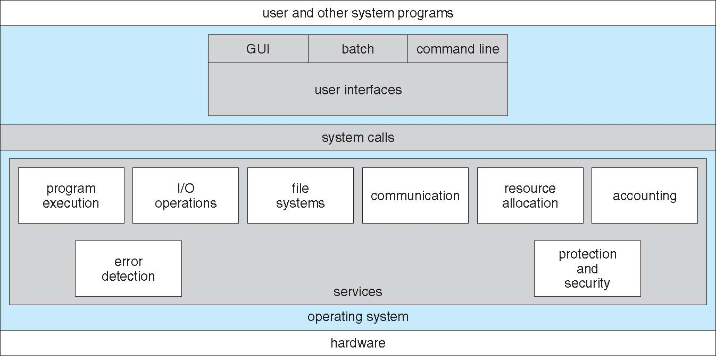
A View of Operating System Services

Slide 9
System Programs
System programs provide a convenient environment for program development and execution
Some of them are simply user interfaces to system calls; others are considerably more complex
They can be divided into:
File manipulation
Status information sometimes stored in a File modification
Programming language support
Program loading and execution
Communications
Background services
Most users’ view of the operation system is defined by system programs, not the actual system calls

Slide 10
System Programs
File management
Create, delete, copy, rename, print, dump, list, and generally manipulate files and directories
Status information
Some ask the system for info - date, time, amount of available memory, disk space, number of users
Others provide detailed performance, logging, and debugging information
Typically, these programs format and print the output to the terminal or other output devices
Some systems implement a registry - used to store and retrieve configuration information

Slide 11
System Programs
File modification
Text editors to create and modify files
Special commands to search contents of files or perform transformations of the text
Programming-language support
Compilers, assemblers, debuggers and interpreters sometimes provided
Program loading and execution
Absolute loaders, relocatable loaders, linkage editors, and overlay-loaders, debugging systems for higher-level and machine language

Slide 12
System Programs
Communications
Provide the mechanism for creating virtual connections among processes, users, and computer systems
Allow users to send messages to one another’s screens, browse web pages, send electronic-mail messages, log in remotely, transfer files from one machine to another
Background Services
Launch at boot time
Some for system startup, then terminate
Some from system boot to shutdown
Provide facilities like disk checking, process scheduling, error logging, printing
Run in user context not kernel context
Known as services, subsystems

Slide 13
OS User Interface

Slide 14
Command Line Interpreter (CLI)
CLI or command interpreter allows direct command entry
Sometimes implemented in kernel, sometimes by systems program
Sometimes multiple flavors implemented – shells
Primarily fetches a command from user and executes it
Sometimes commands built-in, sometimes just names of programs
If the latter, adding new features doesn’t require shell modification
Notes:
What happens in kernel mode?
Kernel mode, also known as system mode, is one of the central processing unit (CPU) operating modes. While processes run in kernel mode, they have unrestricted access to the hardware. The other mode is user mode, which is a non-privileged mode for user programs.

Slide 15
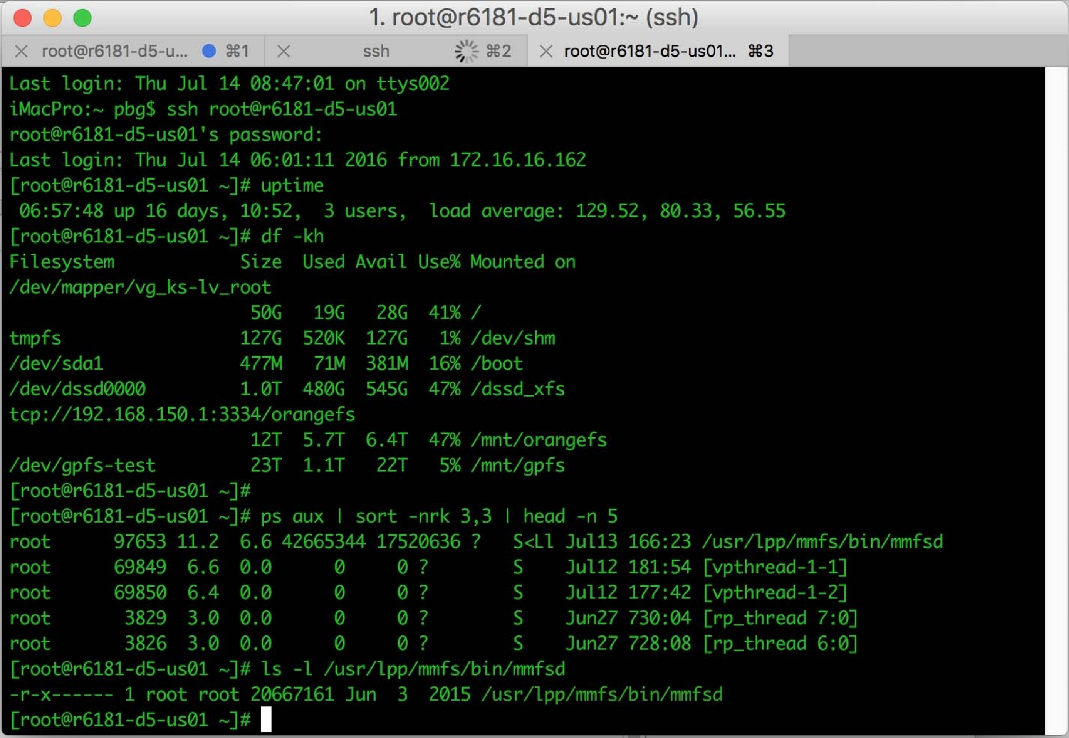
Bourne Shell Command Interpreter

Slide 16
Graphical User Interface (GUI)
User-friendly desktop metaphor interface
Usually mouse, keyboard, and monitor
Icons represent files, programs, actions, etc
Various mouse buttons over objects in the interface cause various actions (provide information, options, execute function, open directory (known as a folder)
Invented at Xerox PARC
Many systems now include both CLI and GUI interfaces
Microsoft Windows is GUI with CLI “command” shell
Apple Mac OS X is “Aqua” GUI interface with UNIX kernel underneath and shells available
Unix and Linux have CLI with optional GUI interfaces (CDE, KDE, GNOME)
Notes:
the representation of familiar desktop items in a user interface to help make the capabilities of a computer clear. The prototypical example is the Macintosh desktop which is used as a backdrop for all application windows and the surface on which files are manipulated.
What is CLI example?
Examples of this include the Microsoft Windows, DOS Shell, and Mouse Systems PowerPanel. Command-line interfaces are often implemented in terminal devices that are also capable of screen-oriented text-based user interfaces that use cursor addressing to place symbols on a display screen.

Slide 17
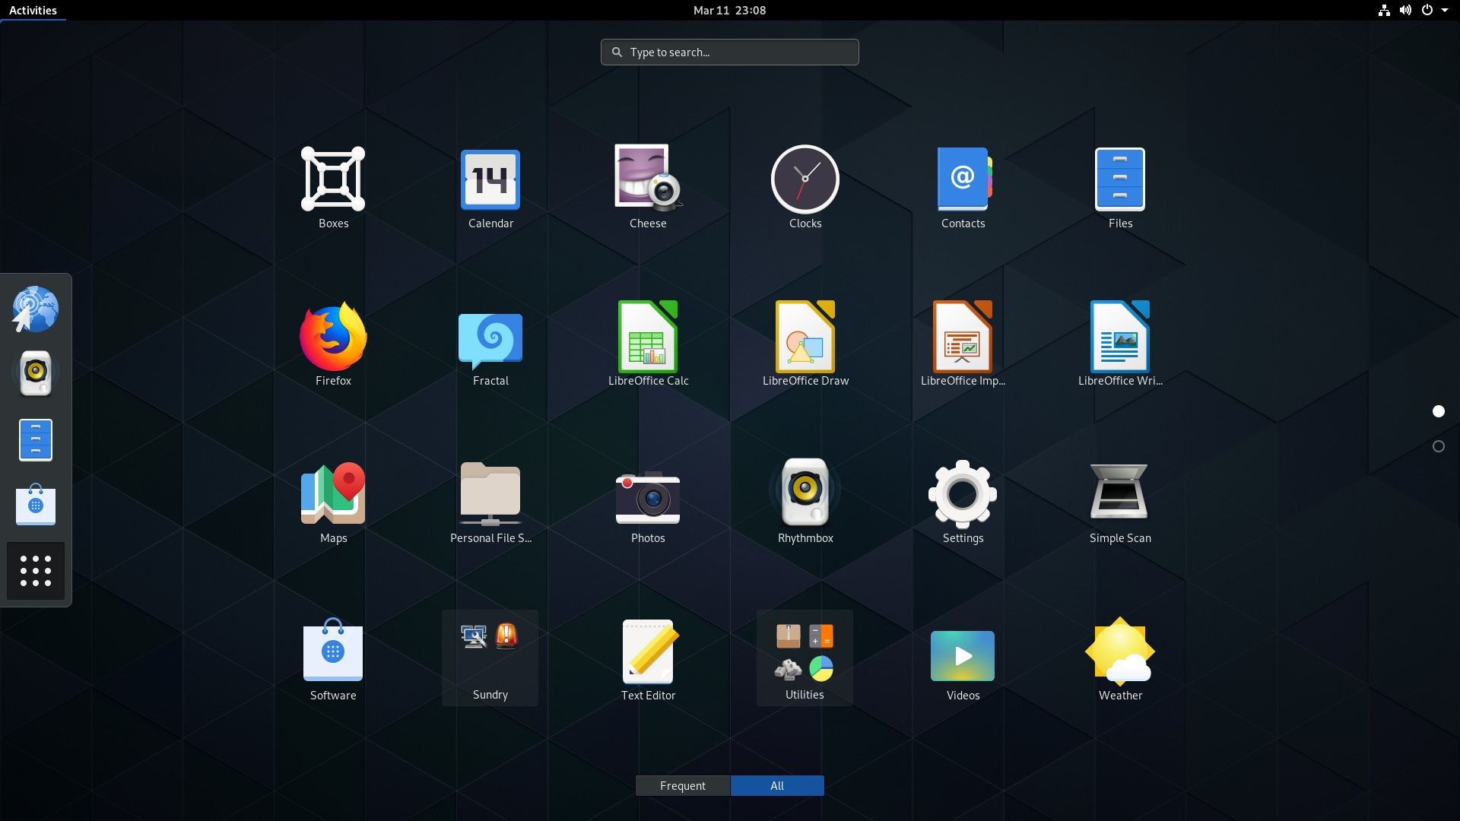
GNOME

Slide 18
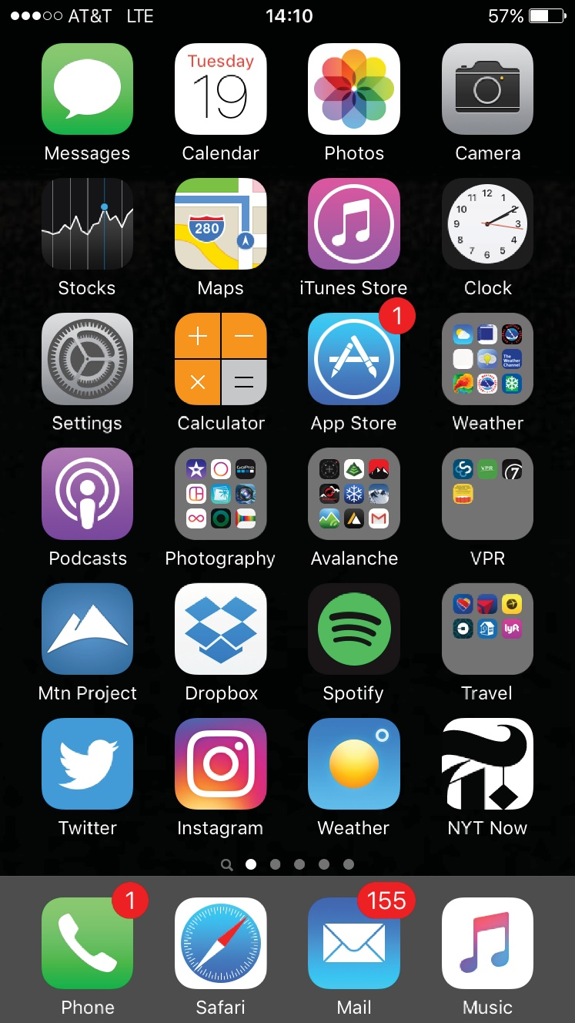
Touch-screen Interface
Touch-screen devices require new interfaces
Mouse not possible or not desired
Actions and selection based on gestures
Virtual keyboard for text entry

Slide 19
Assignment: 2
Deadline: 1st apr 2025

Slide 20
Assignment:2 Write down summary of the data given in the following link in your own words.
https://www.geeksforgeeks.org/different-approaches-or-structures-of-operating-systems/amp/
Search all the system calls written in the slides and describe their working in tabular form.
Submission Instructions:
1. Hand written. Don’t just copy paste it.
2. Make sure it should be in your own words
3. No late submission will be accepted.
4. Submit on moellim.
Should also prepare it as quiz
Note: All assignments are included in Mid and Final term syllabus

Slide 21
Operating System Structure

Slide 22
Operating System Structure
General-purpose OS is very large program
Various ways to structure one as follows

Slide 23
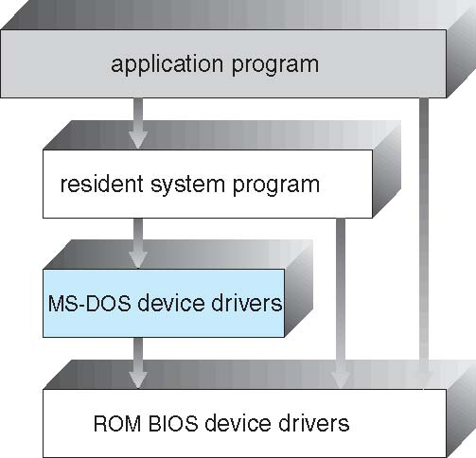
Simple Structure
I.e. MS-DOS – written to provide the most functionality in the least space
Not divided into modules
Although MS-DOS has some structure, its interfaces and levels of functionality are not well separated
Advantages of Simple structure:
It delivers better application performance because of the few interfaces between the application program and the hardware.
Easy for kernel developers to develop such an operating system.
Disadvantages of Simple structure:
The structure is very complicated as no clear boundaries exists between modules.
It does not enforce data hiding in the operating system.

Slide 24
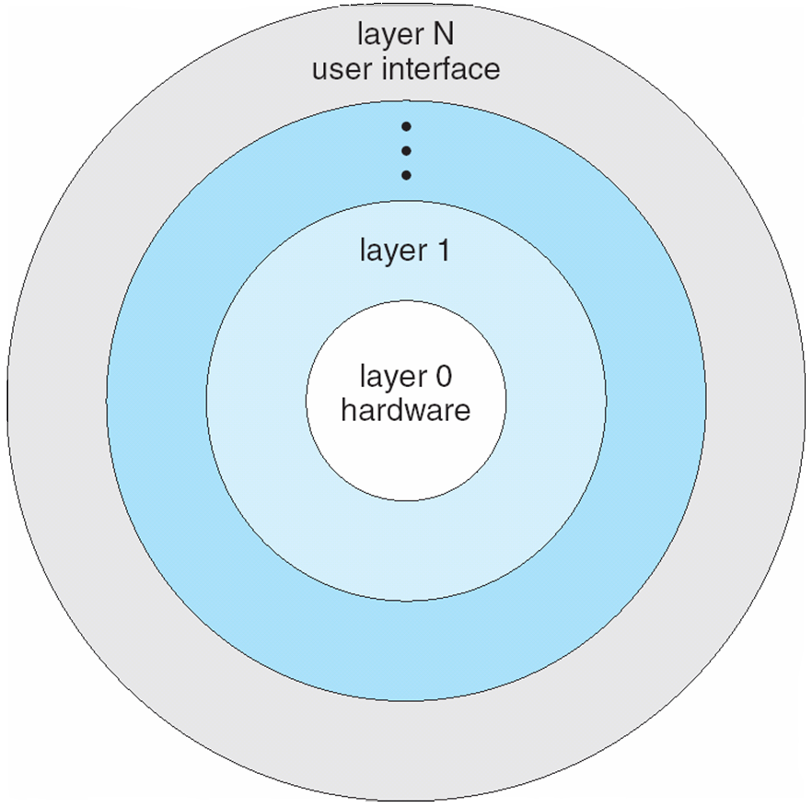
OS Layered Approach
The operating system is divided into a number of layers (levels), each built on top of lower layers
The bottom-most layer (layer 0), is the hardware
The highest (layer N) is the user interface
With modularity, layers are selected such that each uses functions (operations) and services of only lower-level layers
Advantages of Layered structure:
Layering makes it easier to enhance the operating system as implementation of a layer can be changed easily without affecting the other layers.
It is very easy to perform debugging and system verification.
Notes:
Layered Approach
In this type of structure, OS is divided into layers or levels. The hardware is on the bottom layer (layer 0), while the user interface is on the top layer (layer N). These layers are arranged in a hierarchical way in which the top-level layers use the functionalities of their lower-level levels.
This simplifies the debugging process as if lower level layers are debugged and an error occurs during debugging then the error must be on that layer only as the lower level layers have already been debugged.
The main disadvantage of this structure is that at each layer, the data needs to be modified and passed on which adds overhead to the system. Moreover careful planning of the layers is necessary as a layer can use only lower level layers. UNIX is an example of this structure.

Slide 25
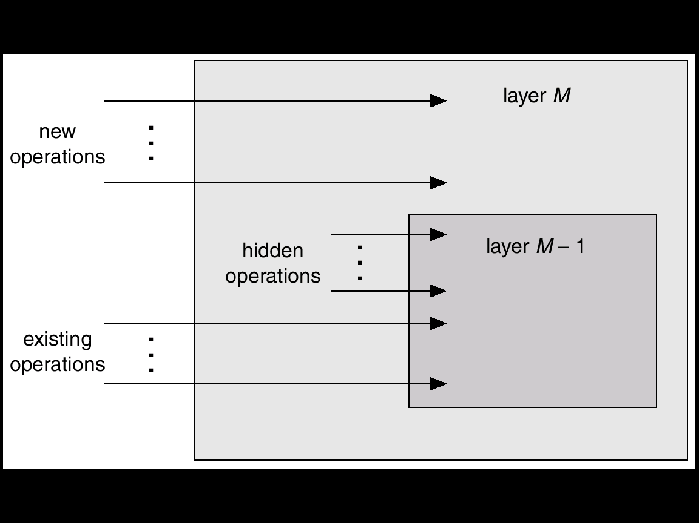
An Operating System Layer

Slide 26
Kernel & Kernel Mode
Kernel is part of operating system that includes most heavily used functions
Generally, kernel is permanently in main memory
Kernel Mode
It is a privileged, nucleus or supervisory mode into which the machine switches when the OS is running
Enables the execution of such privileged instructions
Such as in the area of I/O operations, which are not available to user mode
The techniques by which a user program requests the kernel’s services are;
System calls
Message passing
The process can only be switched into kernel mode by the above actions

Slide 27
Kernel & Kernel Mode
No other way that a user program can execute kernel instructions
This facility is not given to user program in order to enforce system security
User space
User process
Supervisor process
Supervisor
space
Supervisor & user memory

Slide 28
System Calls

Slide 29
System Calls
User program communicate with OS and request its services by making system calls
Corresponding to each system call is a library procedure that user program can call
System calls provide the interface between a running program and the OS
Typically written in a high-level language (C or C++)
All instructions with the hardware are implemented by system calls
Mostly accessed by programs via a high-level Application Programming Interface (API) rather than direct system call use
Three most common APIs are
Win32 API for Windows
POSIX API for POSIX-based systems (including virtually all versions of UNIX, Linux, and Mac OS X)
Java API for the Java virtual machine (JVM)
Notes:
700 system calls in windows
Cout is accessing system call

Slide 30
System Calls Example
Compilation Process Example
To compile a program, a process calls the command interpreter or shell, reads command from the terminal
Shell will create a new process to compile the program
When the process has completed compilation, it executes a system call to terminate itself
Other process system calls are also available to;
Request for more memory
Released unused/extra memory
Process and memory management

Slide 31
System Calls
System calls related to file systems
System calls are needed to create, read, move and write a file
A file should be opened before read it
Similarly, after reading file must be closed which is done by system calls
System calls are required to
create and remove a directory
manipulate file with in different directories
System V Unix (pronounced: "System Five" )provides about 64 system calls e.g.
create(name, amode)
open(name, oflag, amode)
close(fd)
MS-DOS uses software interrupts similar to system calls
Notes:
amode address mode
oflag open file with a specific flag
fd file descriptor, uniqe id

Slide 32
System Call Implementation
Typically, a number is associated with each system call
System-call interface maintains a table indexed according to these numbers
The system call interface invokes the intended system call in OS kernel and returns status of the system call and any return values
The caller need know nothing about how the system call is implemented
Just needs to obey API and understand what OS will do as a result call
Most details of OS interface hidden from programmer by API
Managed by run-time support library (set of functions built into libraries included with compiler)
Notes:
API (Application program interface)

Slide 33
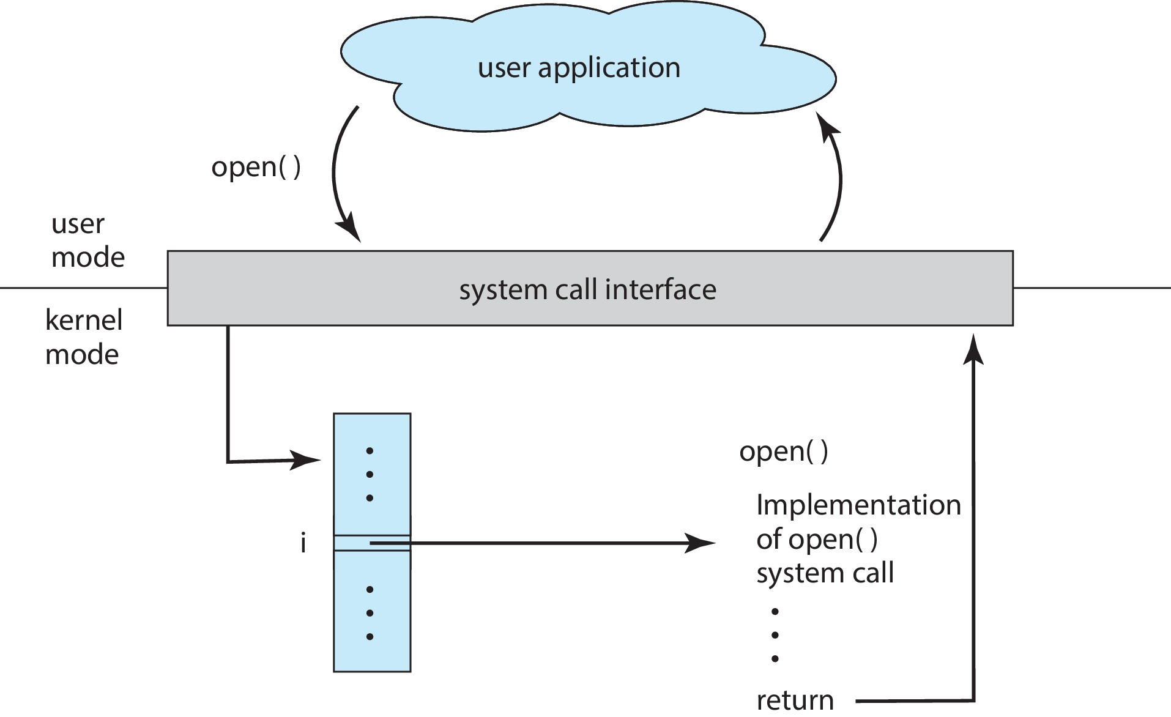
API – System Call – OS Relationship

Slide 34
System Call Processing
Three general methods are used to pass parameters between a running program and the operating system
Pass parameters in registers
Store the parameters in a table in memory, and the table address is passed as a parameter in a register
Push (store) the parameters onto the stack by the program, and pop off the stack by operating system

Slide 35
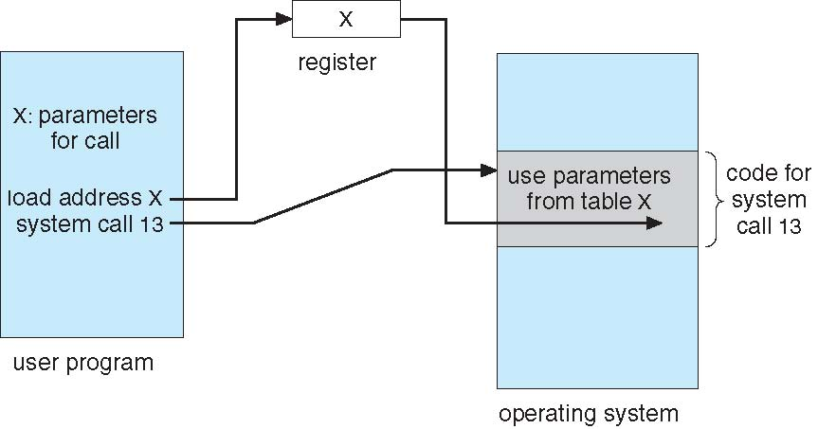
System Call Processing
Parameter Passing via Table

Slide 36
Types of System Calls
Process control
File management
Device management
Information maintenance
Communications

Slide 37
Types of System Calls
Process control
end, abort
load, execute
create process, terminate process
get process attributes, set process attributes
wait for time
wait event, signal event
allocate and free memory
Dump memory if error
Debugger for determining bugs, single step execution
Locks for managing access to shared data between processes

Slide 38
Types of System Calls
File management
create file, delete file
open, close file
read, write, reposition
get and set file attributes
Device management
request device, release device
read, write, reposition
get device attributes, set device attributes
logically attach or detach devices

Slide 39
Types of System Calls
Information maintenance
get time or date, set time or date
get system data, set system data
get and set process, file, or device attributes
Communications
create, delete communication connection
send, receive messages if message passing model to host name or process name
From client to server
Shared-memory model create and gain access to memory regions
transfer status information
attach and detach remote devices

Slide 40
Types of System Calls
Protection
Control access to resources
Get and set permissions
Allow and deny user access

Slide 41
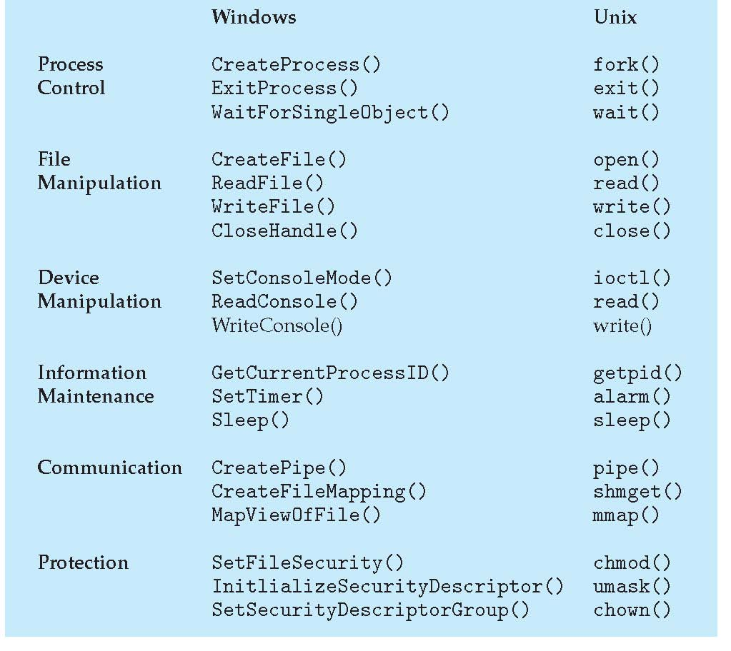
Examples of Windows and Unix System Calls

Slide 42
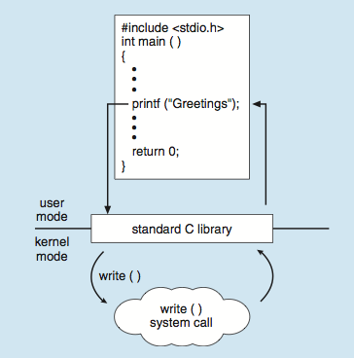
Standard C Library Example
C program invoking printf() library call, which calls write() system call

Slide 43
Operating System Design and Implementation

Slide 44
Operating System Design and Implementation
Design and Implementation of OS not “solvable”, but some approaches have proven successful
Internal structure of different Operating Systems can vary widely
Start by defining goals and specifications
Affected by choice of hardware, type of system
User goals and System goals

Slide 45
OS Design Goals
User goals
System goals
Operating system should be
convenient to use
easy to learn
reliable
safe
fast
Operating system should be
easy to design
implement
maintain
flexible
reliable
error-free
efficient

Slide 46
Operating System Design and Implementation
Important principle to separate
Policy: What will be done?
Mechanism: How to do it?
Mechanisms determine how to do something, policies decide what will be done
The separation of policy from mechanism is a very important principle, it allows maximum flexibility if policy decisions are to be changed later
Specifying and designing OS is highly creative task of software engineering

Slide 47
Operating System Implementation
Much variation
Early OSes in assembly language
Then system programming languages like Algol, PL/1
Now C, C++
Actually usually a mix of languages
Lowest levels in assembly
Main body in C
Systems programs in C, C++, scripting languages like PERL, Python, shell scripts
Code written in a high-level language:
can be written faster
is more compact
is easier to understand and debug
An operating system is far easier to port (move to some other hardware) if it is written in a high-level language

Slide 48
Operating System Debugging
Debugging is finding and fixing errors, or bugs
OS generates log files containing error information
Core Dump
Failure of an application can generate core dump file capturing memory of the process
Crash Dump
Operating system failure can generate crash dump file containing kernel memory and entire system memory information
Beyond crashes, performance tuning can optimize system performance
Sometimes using trace listings of activities describing all process calls, sequence of execution, memory access, system events etc, recorded for analysis
Profiling is periodic sampling of instruction pointer to look for statistical trends

Slide 49
Operating System Generation (SYSGEN)
Operating systems are designed to run on any of a class of machines
the system must be configured for each specific computer site
SYSGEN program obtains information concerning the specific configuration of the hardware system
Used to build system-specific compiled kernel or system-tuned
Can generate more efficient code than one general kernel
SysGen in usually Older technique used in the past.
Customized or tailored according to the needs (sw,hw and user)

Slide 50
System Boot
When power initialized on system, execution starts at a fixed memory location
Firmware ROM used to hold initial boot code
Operating system must be made available to hardware so hardware can start it
Small piece of code – bootstrap loader, stored in ROM or EEPROM locates the kernel, loads it into memory, and starts it
Sometimes two-step process where boot block at fixed location loaded by ROM code, which loads bootstrap loader from disk
Common bootstrap loader, GRUB, allows selection of kernel from multiple disks, versions, kernel options
Kernel loads and system is then running
Notes:
The GRUB (Grand Unified Bootloader) is a bootloader available from the GNU project. A bootloader is very important as it is impossible to start an operating system without it. It is the first program which starts when the program is switched on. The bootloader transfers the control to the operating system kernel.

Slide 51
Interrupts

Slide 52
Interrupts
Mechanism by which hardware like I/O devices, memory modules may interrupt the normal processing of the processor
Interrupts are generated by various agents to notify the OS of the occurrence of some event
such as completion of an I/O activity
When an interrupt occurs, the execution flow of processor is diverted into specific part of OS code which deals with the event – interrupt handler
Interrupts are used to permit several programs and I/O activities to process independently and asynchronously
Hence improve the processing speed

Slide 53
Interrupts
Advantages
It provides a low overheads means of gaining the attention of the CPU
Interrupt Vector Table is a location near the bottom of memory contains the address of interrupt services procedures of I/O devices
Interrupt handling Process
As each instruction terminates, the processor may checks for the occurrence of interrupts
If an interrupt received, the actual program is temporarily suspended, and the processor is diverted to interrupt handling routine
When the interrupt is served, the execution will return to the interrupted program

Slide 54
Interrupts
Example (Printing):
External devices like printer are much slower than the processor
When processor is transferring data to the printer, the processor pause and remain idle until the printer is reading data
I/O modules will send an interrupt request signal to the processor to suspend its current processing and send more data

Slide 55
Interrupt Processing
Following events occurs in processor hardware and software due to an I/O interrupt
The device issue an interrupt signal to processor
The processor finishes execution of current instruction, saves states of interrupted process before responding to the interrupt
The processor sends an acknowledgment signal to the device that issued the interrupt and device remove its interrupt signal/flag
Processor transfer control to the appropriate interrupt handler routine and it starts processing interrupt
When the interrupt is served, the state of interrupted process is restored
Next process starts execution

Slide 56
Types of Interrupts
Interrupts may be generated by a number of sources, which are following
I/O:
Generated by I/O device controller, to signal normal completion of event or the occurrence of an error or failure condition
Time:
Generated by an internal clock within the processor due to expiration of a process’s time quantum or receipt of a signal from another processor on a multiprocessor system
Hardware error:
Generated by hardware faults such as power failure
Program:
Generated in a user program as a result of instruction execution, such as;
Arithmetic overflow
Divide by zero
Attempt to execute an illegal machine instruction
Reference outside a user allowed memory space

